Slide 1
ReDraw
Ross O’Hagan, Brain Gao, Ayush Karawat, Aditya Malik, Connor Wolfe

Slide 2
ReDraw
Created a medium where artists can mess up and “ReDraw” things to make them better
Includes a wide range of tools for artistic expression
What truly separates our application from others is the ability to take an image and make it into a series of strokes as an artist might.

Slide 3
Major Technologies used
p5.js a javascript library made to making coding accessible for artists and designers
Due to limitations in JavaScript libraries had to create several reusable components
Created a Topological Edge Tracer
Connected component labeler for ND-array
Width estimation with successive Morphological openings
All these components work to take images and turn them into a vector of lines strokes like an artist.

Slide 4
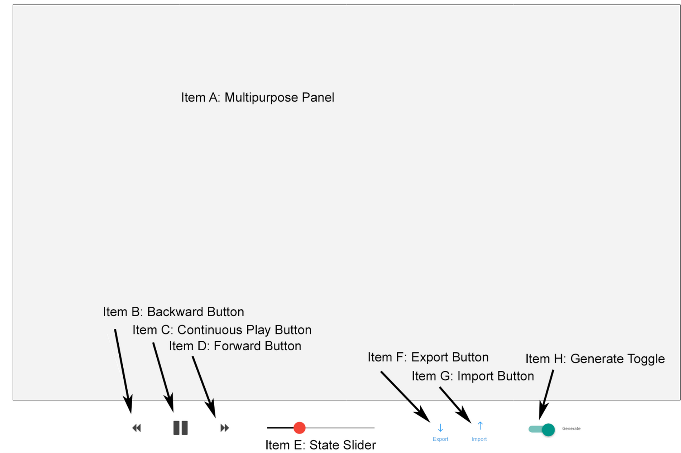
Original Design Proposed

